Slide 1
Object: To determine the specific rotation of cane sugar solution by bi- quartz polarimeter.
Apparatus used:
Bi-quartz polarimeter
Balance
Measuring cylinder
Beaker
Source of light

Slide 2
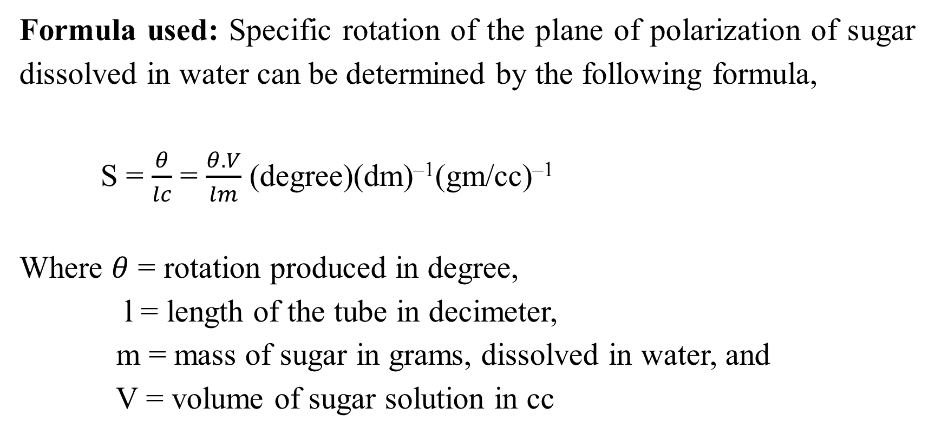
Formula used: Specific rotation of the plane of polarization of sugar dissolved in water can be determined by the following formula,
S = $\frac{θ}{lc}$ = $\frac{θ.V}{lm}$ (degree)(dm)^{–1}(gm/cc)^{–1}
Where $θ$ = rotation produced in degree,
l = length of the tube in decimeter,
m = mass of sugar in grams, dissolved in water, and
V = volume of sugar solution in cc

Slide 3
Theory: Source of light S is placed at the focus of convex lens. The beam becomes parallel after passing through lens and then passes through polarizer. The polarized light passes through the bi-quartz plate and travels the length of the polarimeter tube made of glass. The light is analyzed with the help of the analyzer, which can be rotated about a horizontal axis, and position can be read by a vernier moving over a fixed graduated circular scale. The light is now viewed with the help of a telescope. The analyzer and telescope are placed in the same tube.

Slide 4
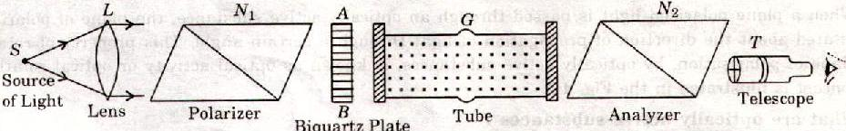
Experimental arrangement for specific rotation of cane sugar

Slide 5
Procedure:
Take the polarimeter tube and clean well both sides such that these are free from dust.
Fill the tube with pure water and see that no air bubble is enclosed in it.
Place the polarimeter tube in its position inside the polarimeter.
Switch on the source of light (mercury lamp) and look through the eyepiece. Two halves of the field view will be visible with different colors.
Move the eyepiece till two halves of the fields appear equally colored.
Take the reading of main scale, vernier scale and find out the total reading.
Now, prepare a sugar solution of known strength.
Remove the pure water from the polarimeter tube and fill it with the prepared sugar solution and again repeat the above procedure.
Finally, measure the length of the polarimeter tube by a meter scale.

Slide 6
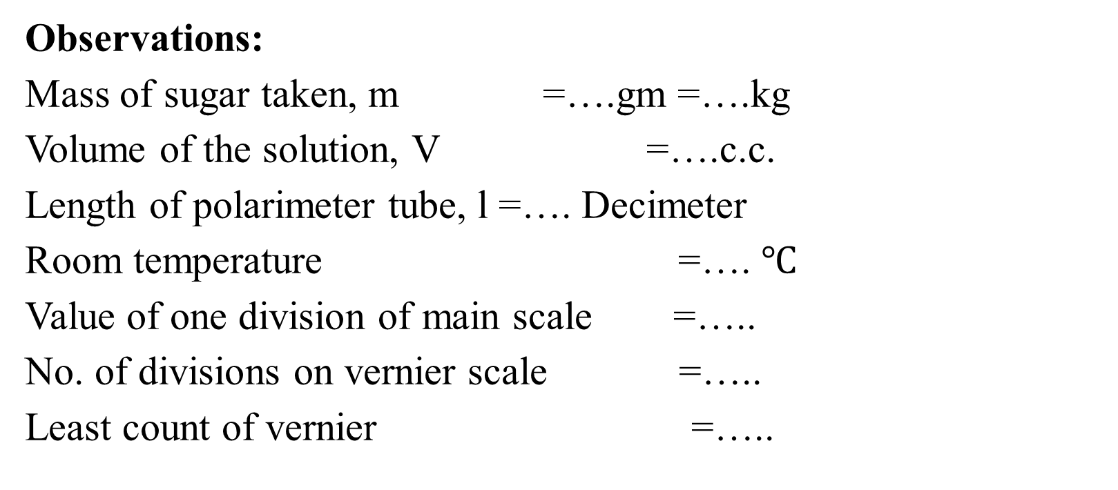
Observations:
Mass of sugar taken, m =….gm =….kg
Volume of the solution, V =….c.c.
Length of polarimeter tube, l =…. Decimeter
Room temperature =…. $℃$
Value of one division of main scale =…..
No. of divisions on vernier scale =…..
Least count of vernier =…..

Slide 7
Observations ( continued……)
S. No. | Water |  |  |  | Concen-tration | Cane sugar |  |  |  | A= (a-e) (deg.) | B = (b-f) (deg.) | C = (c- g) (deg.) | D = (d- h) (deg.)
 | Initial position |  | After rotation 180° |  |  | Initial position |  | After rotation 180°
 | Clock Wise (a) (deg.) | Anti clock-wise (b) (deg.) | Clock Wise (c) (deg.) | Anti clock-wise (d) (deg.) |  | Clock Wise (e) (deg.) | Anti clock-wise (f) (deg.) | Clock Wise (g) (deg.) | Anti clock-wise (h) (deg.)

Slide 8
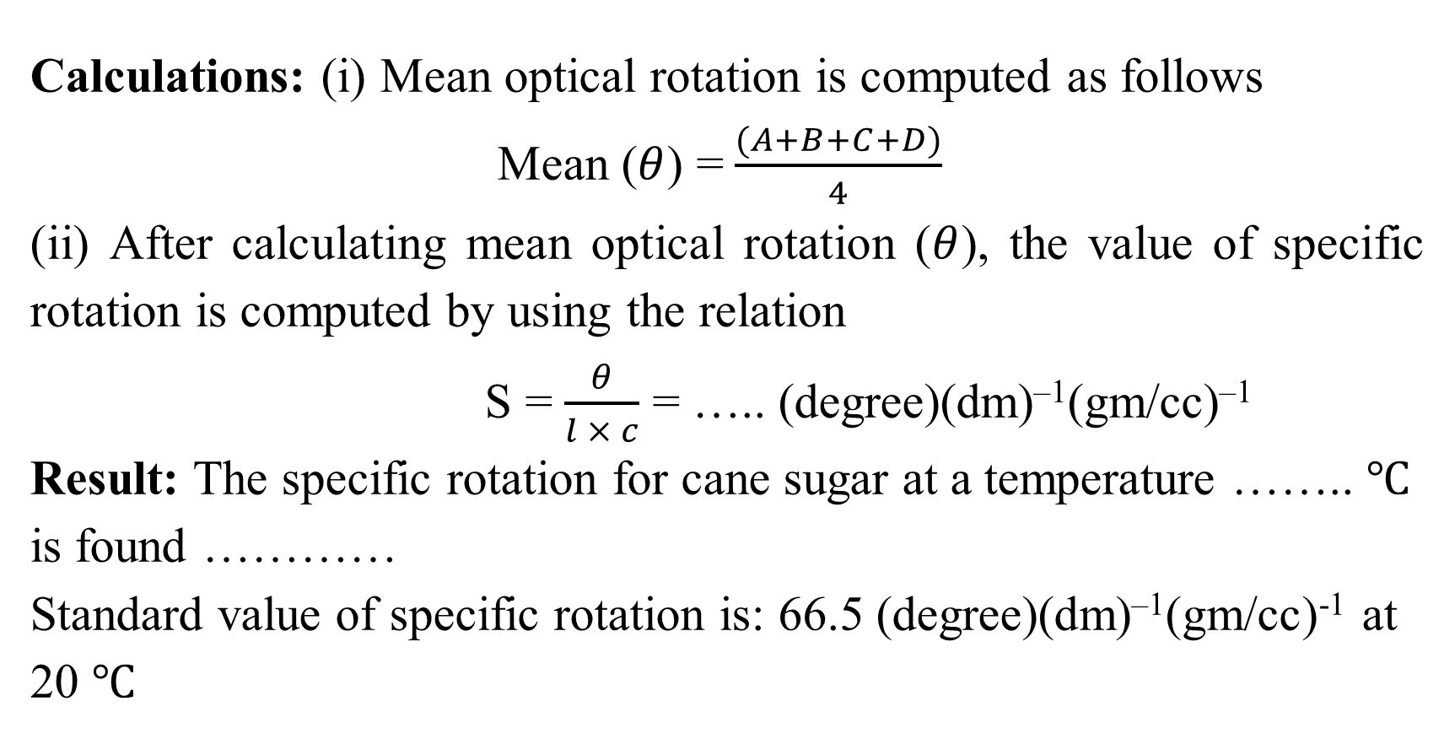
Calculations: (i) Mean optical rotation is computed as follows
Mean ($θ$) =$\frac{(A+B+C+D)}{4}$
(ii) After calculating mean optical rotation ($θ$), the value of specific rotation is computed by using the relation
S = $\frac{θ}{l × c}$ = ….. (degree)(dm)^{–1}(gm/cc)^{–1}
Result: The specific rotation for cane sugar at a temperature …….. $℃$ is found …………
Standard value of specific rotation is: 66.5 (degree)(dm)^{–1}(gm/cc)⁻¹ at 20 $℃$

Slide 9

Percentage error: It is calculated by using the relation
Percentage error = $\frac{Oveserved value−Standard value}{Standard value}×100=…\%$
Precautions:
The glass plate and the lens should be thoroughly cleaned.
The microscope’s eyepiece should be properly focused on its cross-wire.
The microscope should be moved only one direction to avoid backlash error.
The lens should be used of large radius of curvature.
The range of microscope should be properly adjusted before measuring the diameter of the rings.

Slide 10
Questions
Q1. What do you understand by unpolarised light?
Q2. What is polarised light?
Q3. How will you identify whether a beam is polarised or unpolarised?
Q4. Describe plane of polarisation and plane of vibrations.
Q.5 What is meant by specific rotation?
Q.6 Define optical activity.
Q.7 Explain the term “tint of passage”.
Q.8 Why the colour in the two halves of the field of view becomes identical in the situation of “tint of passage”.
Q.9 Why do the optically active substances rotate the plane of polarisation?
Q.10 Explain the dextro and levo rotatory substances.

